Slide 1

[Insert organization’s name]
[INSERT REPORT NAME]
[Insert date]
[Insert logo]

Slide 2
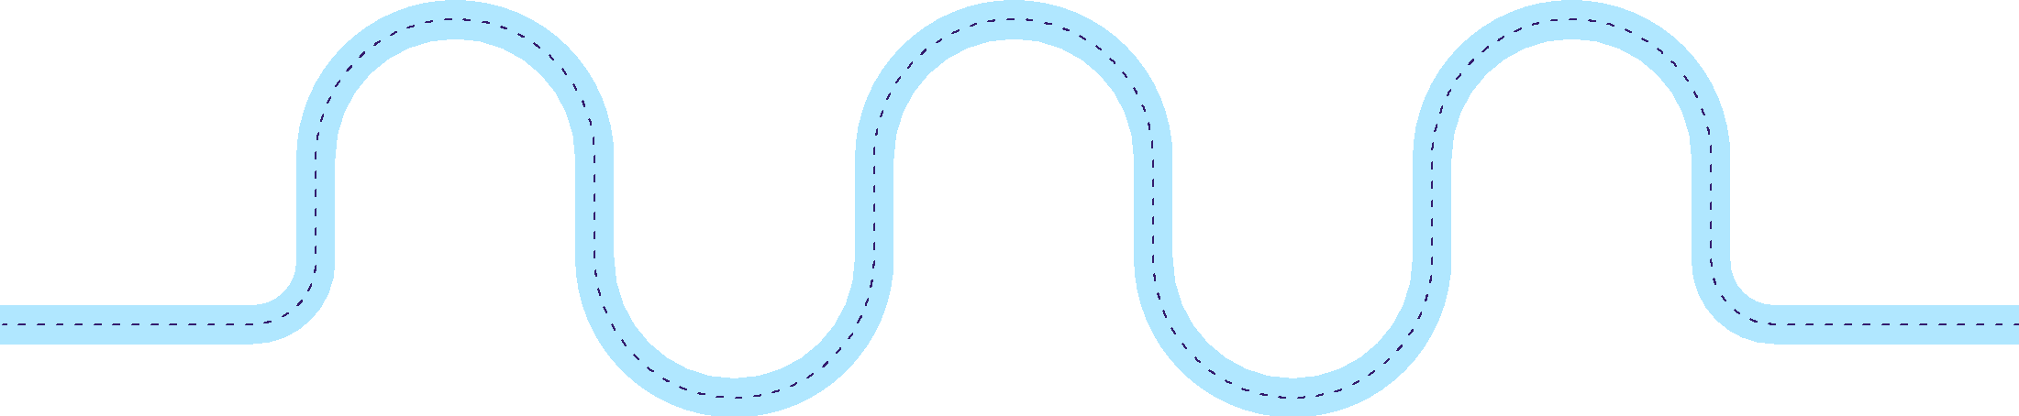
Table of Contents
[Insert logo]
Executive summary
Key metrics
Risks & mitigations
Focus for upcoming period
1
3
5
7
2
4
6
Workforce profile
Strategic initiatives update
Discussion points

Slide 3
EXECUTIVE SUMMARY

Slide 4
Executive summary
[Insert logo]
[Summarize what the board will read in this report. Write maximum three paragraphs]

Slide 5
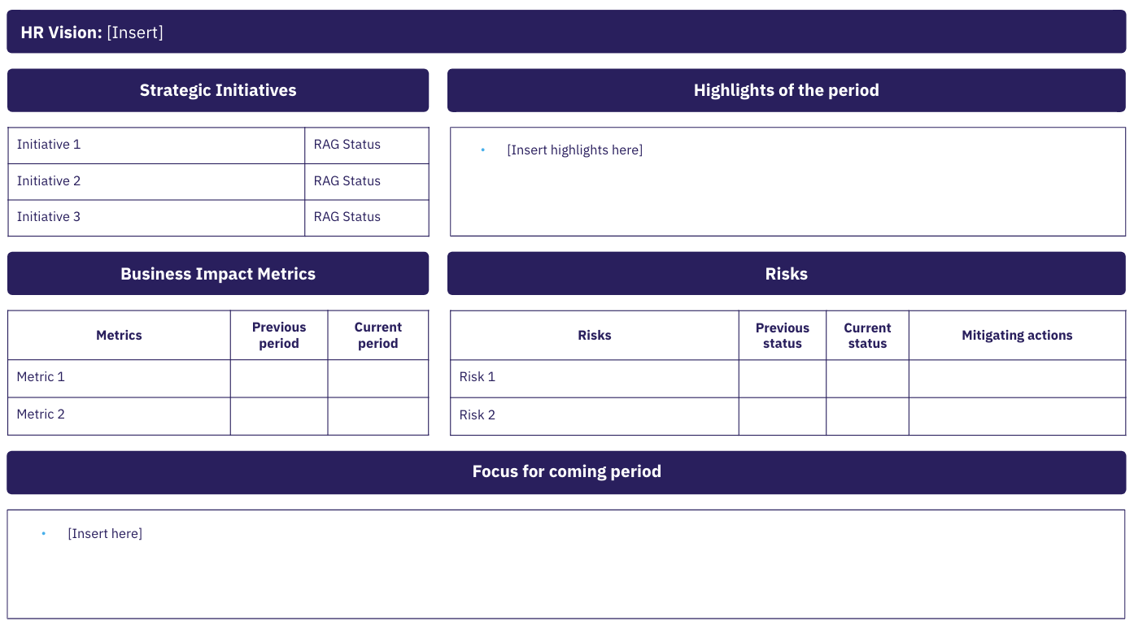
Show the current progress of the initiative using the colors Red - Amber - Green (RAG)
On track to achieving goal
Insert vision statement from People strategy
Risk of missing goal
Instructions
At risk — require action
Insert what HR is focusing on based on the HR strategy
Insert what has been achieved during this quarter
Insert what metrics you are monitoring to show the impact of HR
Insert actions you are taking to mitigate the risk
Insert your focus for the coming period
Insert number/percentage from previous period
Insert number/percentage from current period. Note if it’s going up or down
Insert the risk you are monitoring
Show previous and current status using the colors Red - Amber - Green (RAG)

Slide 6
HR Vision: Become a talent destination for critical talent
Example
Strategic Initiatives
Highlights of the period
Reposition our EVP within the desired talent segments
Build a sustainable and diverse leadership pipeline
Cultivate a culture of high performance
Launch our Leadership Academy with Top 100 leaders in partnership with vendor
Completed annual engagement survey feedback with business units and increased levels by 7% from last year
Implementation of new talent acquisition platform which brought time to hire down by 26%
Business Impact Metrics
Risks
Metrics | Previous period | Current period
eNPs | 43 | 56
Turnover Rate YoY Comparison | 26% | 34%
Risks | Previous status | Current status | Mitigating actions
Diversity of current leadership pool |  |  | Retention plans in place for key talent
Return to the office approach |  |  | Policy communicated and implemented
Focus for coming period
Requests for proposal for vendors to partner with on implementation for new Enterprise Resource Planning Technology
Annual retail employee career fair with focus on diversification of recruitment channels
Top Employer Audit

Slide 7
HR Vision: [Insert]
Strategic Initiatives
Highlights of the period
Initiative 1 | RAG Status
Initiative 2 | RAG Status
Initiative 3 | RAG Status
[Insert highlights here]
Business Impact Metrics
Risks
Metrics | Previous period | Current period
Metric 1
Metric 2
Risks | Previous status | Current status | Mitigating actions
Risk 1
Risk 2
Focus for coming period
[Insert here]

Slide 8
WORKFORCE PROFILE

Slide 9
Workforce demographics
[Insert logo]
Full-time employees headcount per department
Age distribution of full-time employees
[Discuss significant shifts in the number of full-time employees, diversity, or age structure this quarter/month compared to last quarter/month. Provide explanations for these changes]
Department | Last quarter | This quarter | Quarter on quarter change
Marketing | [Enter number] | [Enter number] | [% change]
Sales | [Enter number] | [Enter number] | [% change]
Human resources | [Enter number] | [Enter number] | [% change]
Finance | [Enter number] | [Enter number] | [% change]
Operations | [Enter number] | [Enter number] | [% change]
Research & Developments | [Enter number] | [Enter number] | [% change]
IT | [Enter number] | [Enter number] | [% change]
[Additional department] | [Enter number] | [Enter number] | [% change]
TOTAL | [Enter number] | [Enter number] | [% change]
[Insert data visualization here]
Race and ethnicity data of full-time employees
[Insert data visualization here]
X%

Slide 10
Employee structure
[Insert logo]
Hierarchical level distribution of full-time employees
Tenure of full-time employees
[Insert data visualization here]
[Insert data visualization here]
[Discuss significant shifts in employee tenure or hierarchical level this quarter/month compared to last quarter/month. Provide explanations for these changes]
X%

Slide 11
KEY METRICS

Slide 12
Employee productivity
[Insert logo]
Profit per employee
Revenue per employee
[Provide a short analysis of why the numbers have increased/decreased and discuss any significant shifts in these metrics along with potential reasons]
[Insert visualization here]
[Insert visualization here]
X%

Slide 13
Employee productivity
[Insert logo]
[Provide a short analysis of why the cost per hire has risen/dropped, discuss factors affecting time to fill duration, and mention how quality of hire is being evaluate and its implication]
Cost per hire
Time to fill
Quality of hire
[Insert visualization here]
[Insert visualization here]
[Insert visualization here]
X%

Slide 14
Employee engagement & satisfaction
[Insert logo]
Employee Net Promoter Score
Employee engagement score
[Insert data visualization here]
[Insert data visualization here]
[Provide an analysis of factors contributing to the rise or drop in eNPS and discuss what’s driving employee engagement scores]
X%

Slide 15
Turnover & retention update
[Insert logo]
[Provide a short analysis of the reasons behind any significant increase or decrease in turnover, and discuss your retention strategies and their outcomes]
Turnover rate
Turnover cost
Retention rate
[Insert visualization here]
[Insert visualization here]
[Insert visualization here]
X%

Slide 16
STRATEGIC INITIATIVES UPDATE

Slide 17
[Insert initiative name]
[Insert logo]
[Provide a concise overview of this initiative]
Status
[Insert visualization here]
Challenges
Key learnings
Milestones
Challenges | Solutions
[Brief description of the challenge] | [Brief description of your solution]
[Brief description of the challenge] | [Brief description of your solution]
… | ..
[Brief description of what you’ve learned from this initiative]
[List the milestones that you have achieved in your initiative]
Decision required
[Include any requests for board actions that you might have]

Slide 18
RISKS & SOLUTIONS

Slide 19
[Insert risk name]
[Insert logo]
[Write one or two sentences to give a concise overview of the risk]
Status
[Insert previous period] | [Brief description]
[Insert current period] | [Brief description]
Impact
Mitigating actions
 | Description | Impact level
Impact 1 | [Provide a brief description of the potential repercussions or fallout of the risk] | [High, medium, or low]
Impact 2 | [Provide a brief description of the potential repercussions or fallout of the risk] | [High, medium, or low]
… | … | ..
 | Description | Timeline
Action 1 | [Provide a short description of the action] | [Projected date or time frame]
Action 2 | [Provide a short description of the action] | [Projected date or time frame]
… | … | ..
X%

Slide 20
DISCUSSION POINTS

Slide 21
Discussion points
[Insert logo]
[Insert topic name]
[Provide a brief description of topic and why it needs to be discussed]
1
[Insert topic name]
[Provide a brief description of topic and why it needs to be discussed]
2
[Insert topic name]
[Provide a brief description of topic and why it needs to be discussed]
3
[Insert topic name]
[Provide a brief description of topic and why it needs to be discussed]
4

Slide 22
FOCUS OF UPCOMING PERIOD

Slide 23
Focus of upcoming period
[Insert logo]
[Insert focus 1]
[Insert focus 2]
[Insert focus 3]
[Briefly explain your rationale]
[List some potential challenges that you expect to encounter]
[List the resources that you need]
[Briefly explain your rationale]
[List some potential challenges that you expect to encounter]
[List the resources that you need]
[Briefly explain your rationale]
[List some potential challenges that you expect to encounter]
[List the resources that you need]

